Slide 1
What Are Templates?
Templates are pre-made designs or documents that can be customized. It is a
document that you can copy and fill in the variable parts. Templates can be a one-stop shop or a starting point that inspires you. You can take existing templates or patterns and tailor it to fit your own needs.
Why Use Templates?
Tempted to Use Templates?
Templates can be a useful and time-saving tool by helping to simplify the creation of flyers, emails, posters, newsletters, etc. Templates can help put information onto web pages, build social media posts, and create flyers and presentations that look professional and on brand. They can ease our workload and make us feel less stressed, and, at the same time, they increase efficiency. By using templates your designs are uniform and create a sense of familiarity that gives a sense of structure and consistency to the design piece.
Where Can I Find Templates?
Designing and creating professional looking material has never been easier or
more fun. There are lots of places where you can find free graphic design templates. One of these is Canva. It is user friendly with a lot of built-in features for resizing, adding text, color and elements to your designs. Postal employees must access canva.com through Google Chrome.
Please note that the Postal Service cannot recommend or promote one product, service, or resources over another. We want to make you aware of a FREE graphic tool that is loaded with templates.
We also have templates that you can use on _________________________
Even though templates make designing almost flawless it does not mean that it should stop
you from designing your own piece from scratch
which can serve as a template for future use.

Slide 2
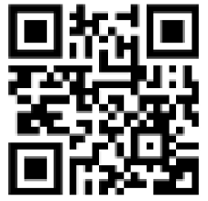
The Tempting PCC Template Challenge
Even though editable templates make designing almost flawless, it shouldn’t stop you from having a little creative fun by designing your own marketing piece from scratch which can serve as a template for future use.
The Tempting PCC Template Challenge ?
The Communication and Marketing Sub-Committee is tempting your PCC to participate in our PCC Template Challenge.
Beginning May 1, 2022 through May 31, 2022, we invite you to share your best PCC template(s) on the PCC Voice LinkedIn.
So be daring, clever and devilishly creative, but mostly have fun!
In addition to winning a special prize, our winning entries will be featured on our “Templates” page.
Not a Member of the PCC Voice LinkedIn?
No problem, simply scan the following QR code and start posting today!

Slide 3
YOUR CHARTER LOGO
First-Class Mail
Postage & Fees Paid
USPS
Permit No. G-10
City, State zip
Return Address
TO:
Print and mail
services donated by
NAME & LOGO
FRONT
BACK
TITLE OF EVENT - DATE
TITLE
YOUR CHARTER LOGO
HOST/ HOSTS NAMES
DATE
Type of meeting; Zoom, in person
GRAPHIC OR KEY POINTS
BRIEF SYNOPSIS OF EVENT
LOCATION
TIME/AGENDA
QR
CODE
COST?
WEBSITE – CONTACT INFO

Slide 5
Examples of Templates
The following are examples of templates that you can customize to your PCC.
PCC Business Cards
The PCC Future
is So Bright You
Gotta Wear Shades
Scan me to
learn more!!
VALUE OF BECOMING A PCC MEMBER
VALUE OF BECOMING A PCC MEMBER
New Sources
Networking
Best Practices
New Sources
Networking
Best Practices
Knowledge
Innovative Ideas
Expert Advice
Free Membership
Knowledge
Innovative Ideas
Expert Advice
Free Membership
Scan me to
learn more!
Scan me to
learn more!

Slide 6
Certificate of Appreciation

Slide 7
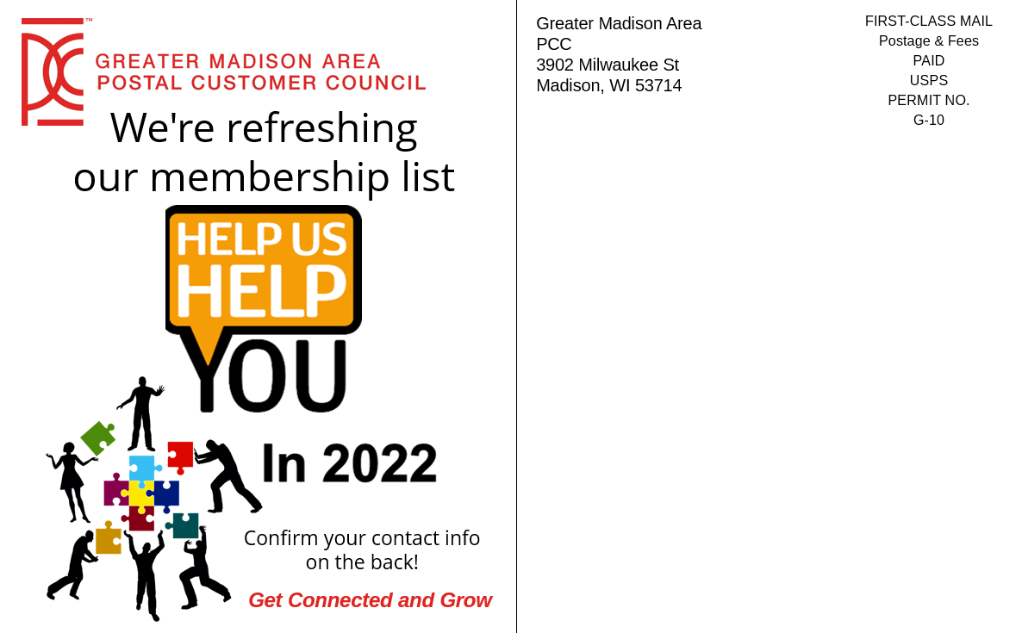
Examples of Templates
The following are examples of templates that you can customize to your PCC.
Postcard Mailer

Slide 8
POSTAL CUSTOMER COUNCIL
City, State zip
Return Address
First-Class Mail
Postage & Fees Paid
USPS
Permit No. G-10
TO:
Print and mail
services donated by
NAME & LOGO
FRONT
BACK
TITLE OF EVENT - DATE
TITLE
YOUR CHARTER LOGO
HOST/ HOSTS NAMES
DATE
Type of meeting; Zoom, in person
GRAPHIC OR KEY POINTS
BRIEF SYNOPSIS OF EVENT
LOCATION
TIME/AGENDA
QR
CODE
COST?
WEBSITE – CONTACT INFO

Slide 9
Certificate of Achievement
Certificate of Achievement
Awarded to
Awarded to
Sharon Barger
Sharon Barger
FOR SUCCESSFULLY COMPLETING THE CERTIFICATE PROGRAM FOR THE:
FOR SUCCESSFULLY COMPLETING THE CERTIFICATE PROGRAM FOR THE:
EMERALD AWARD LEVEL
EMERALD AWARD LEVEL
PCC Postal Co-Chair
PCC Postal Co-Chair
Date
Date
PCC Industry Co-Chair Date
PCC Industry Co-Chair Date

